Slide 1
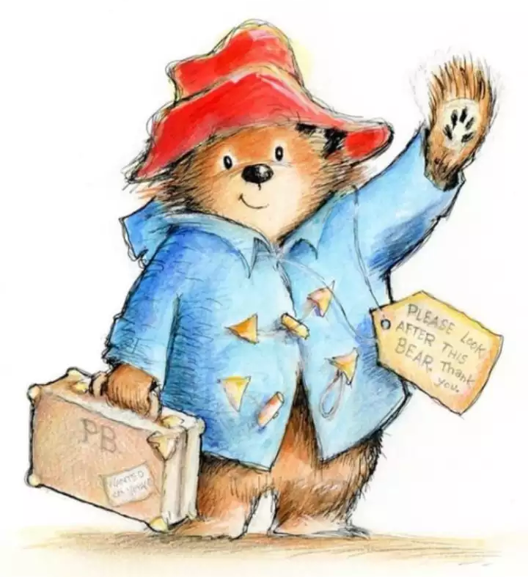
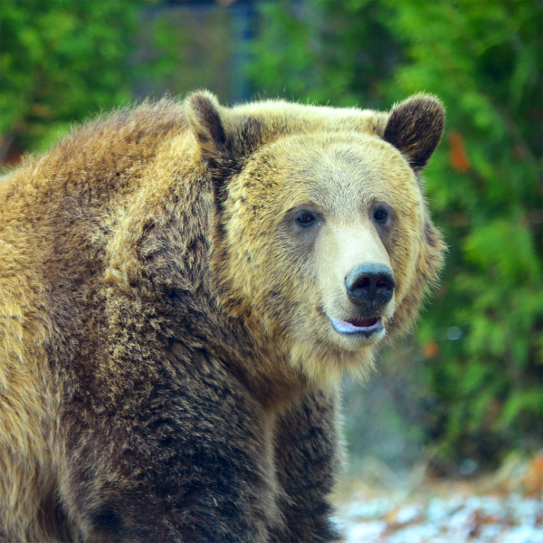
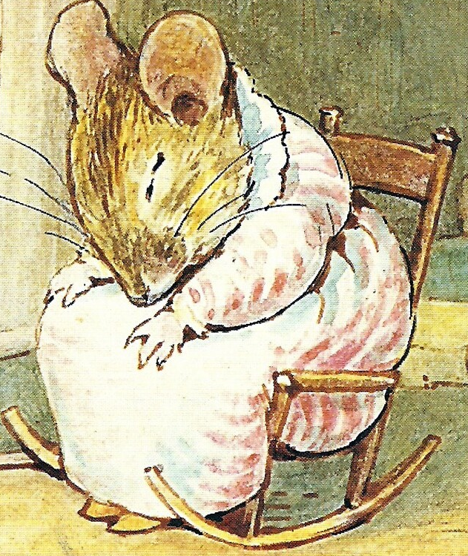
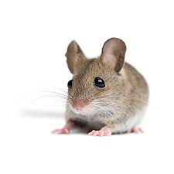
Do animal characters help children learn about science?
By Shumita Littlefield

Slide 2
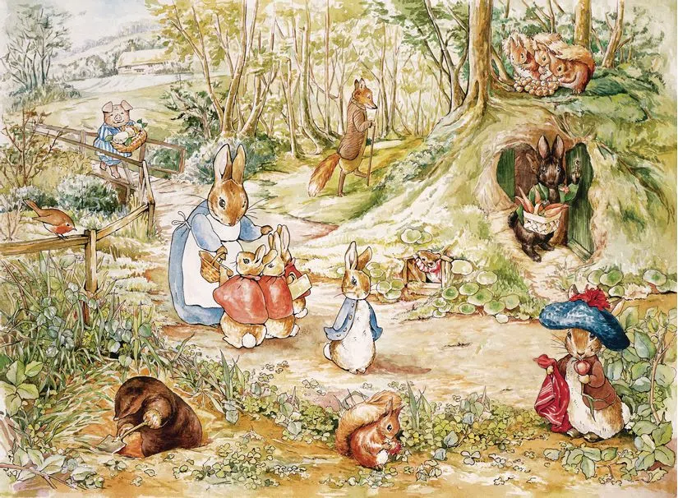
There have always been animal characters
When presented with books about humans or about animals, children are more likely to choose the animal story (Conrad, 2021)
This trend has persisted throughout time
Do children learn about animals from these characters?

Slide 3
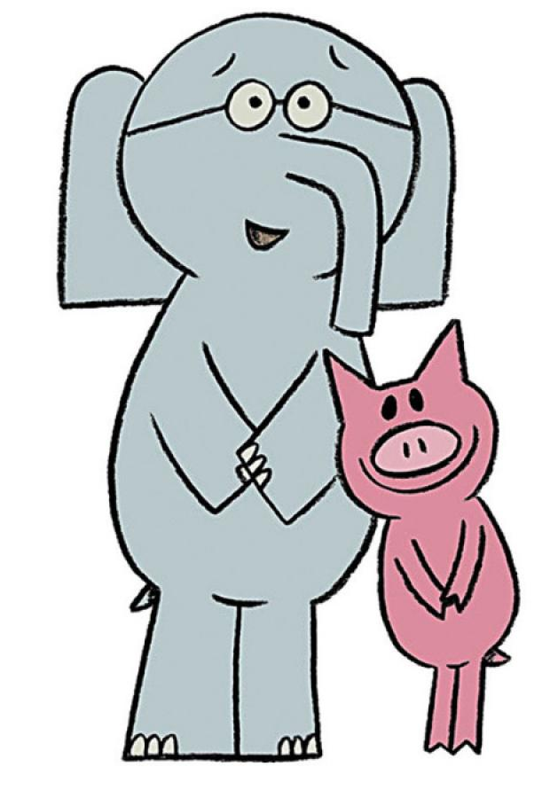
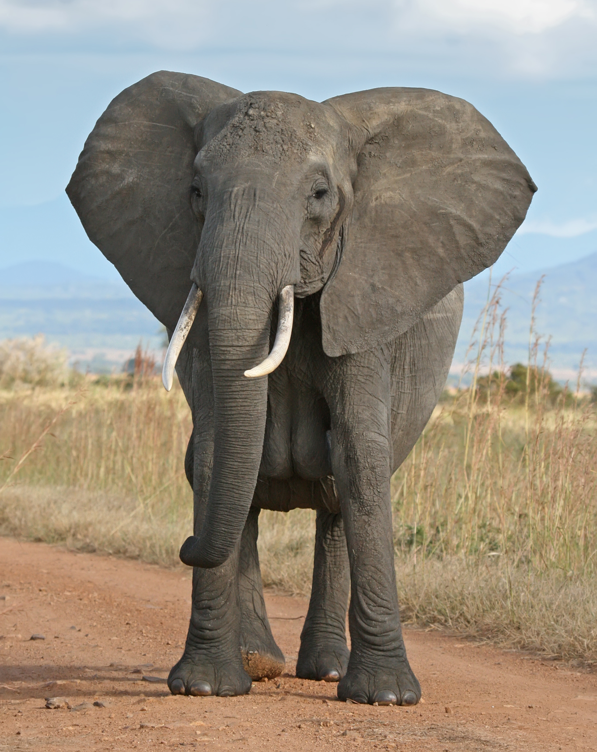
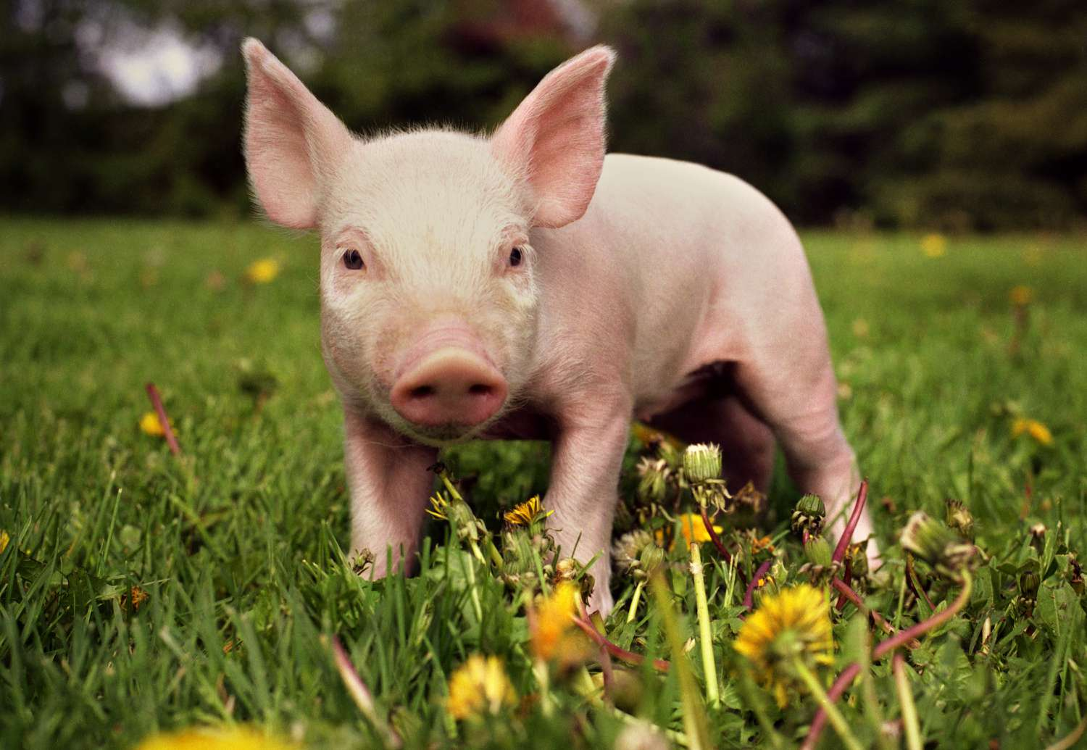
‘Humanness’ distances stories from real animals
When an animal character is ‘too’ human-like, children struggle to associate it with real animals
It is more effective to depict animal characters engaging in behavior true to their species (Geerdts, 2016)

Slide 4
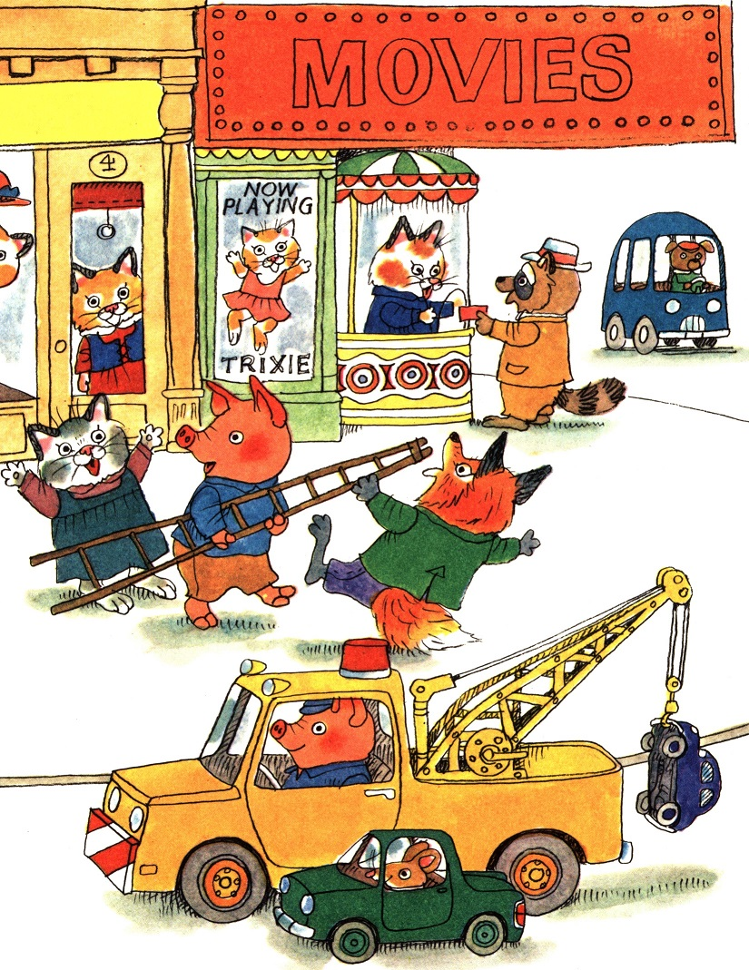
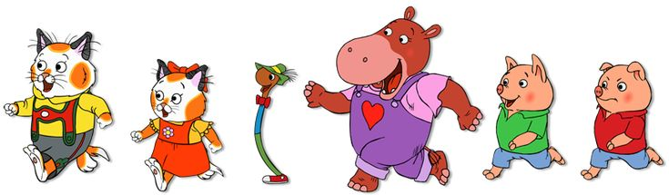
VISUAL humanness distances stories from real life
Children only struggle with animal characters that look and act like humans
Text in stories can use human characteristics and qualities to describe animal characters, and children will still associate the character with real animals (Geerdts, 2016).

Slide 5
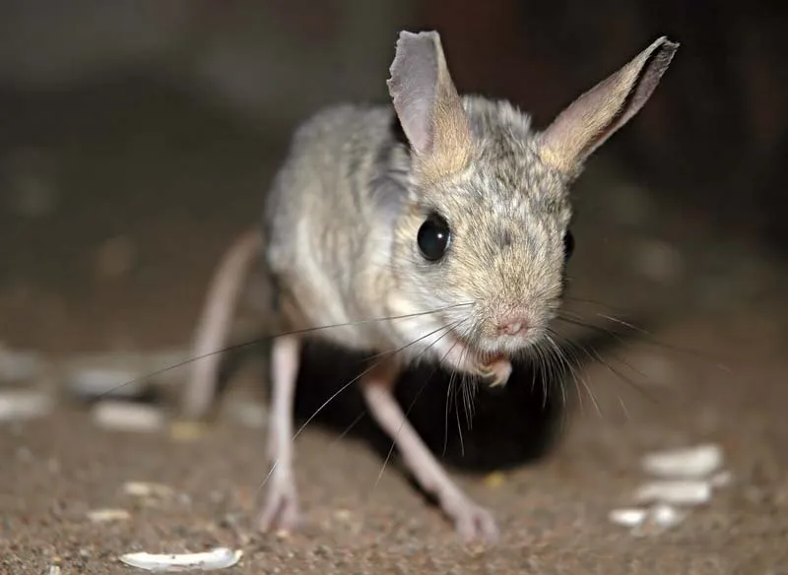
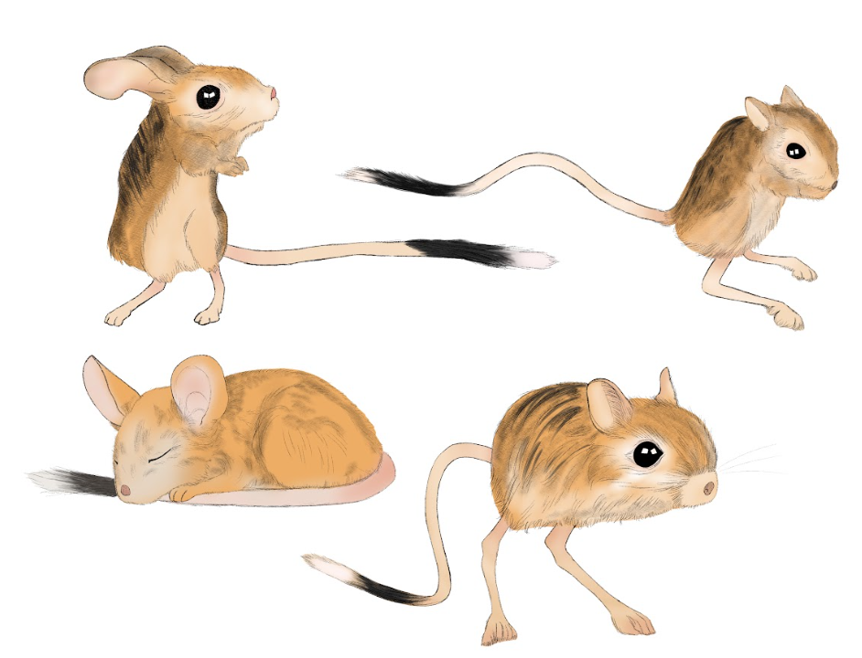
The most effective combination
Based on my research, I believe that the most effective way to teach children about animals through stories is to use realistic images and anthropomorphic descriptions
I chose an unfamiliar animal (Jerboa) to reduce interference from prior knowledge

Slide 6
Works Cited
Britannica, T. Editors of Encyclopaedia (2021, April 4). jerboa. Encyclopedia Britannica. https://www.britannica.com/animal/jerboa
This article also contains basic information about the jerboa, though it goes a bit more in depth than the WWF article. Some jerboa traits are highly variable, such as ears or color. They have extremely short front limbs and long back limbs. The color of the jerboa largely depends on their environment and what will blend in more. Their main competitors are gerbils. They can jump 10 ft far and 6 ft upwards. They don’t drink water and they stay underground in burrows during the day and the winter.
Conrad, M., Marcovitch, S., & Boseovski, J.J. (2021). The friendly fossa: The effect of anthropomorphic language on learning about unfamiliar animals through both storybooks and live animal experiences. Journal of Experimental Child Psychology, 201. https://doi.org/10.1016/j.jecp.2020.104985.
This article discusses anthropomorphic descriptions of animals within a storybook context as well as a zoo context, but I will be focusing on storybooks. This article states that books about animal characters are generally more popular, specifically in a preschool setting. There is also emphasis on the degree of ‘humanness” the animal characters have; the more human they seem, the less children will associate them with real animals.
Geerdts, M.S. (2016). (Un)Real Animals: Anthropomorphism and Early Learning About Animals. Child Development Perspectives, 10(1), 10-14. https://doi.org/10.1111/cdep.12153
The results of this study indicate that anthropomorphism has a negative impact on children’s learning. It is stated that in early education, anthropomorphizing animals will hinder children in learning about different types of animals and other biological knowledge, though older children (high school age), generally find anthropomorphism helpful in learning science.
Geerdts, M. S., Van de Walle, G. A., & LoBue, V. (2016). Learning About Real Animals From Anthropomorphic Media. Imagination, Cognition and Personality, 36(1), 5-26. https://doi-org.ezproxy.bu.edu/10.1177/0276236615611798
Interestingly enough, the same author as (Un)Real Animals: Anthropomorphism and Early Learning About Animals, has worked on this article, and states that contrary to previous ideas, anthropomorphism does not interfere with children’s ability to learn biology and animal science. This article also emphasizes that children have a preference for stories featuring animal characters rather than human characters. It is also emphasized that what really matters is the degree of anthropomorphism of the animal characters. It is even stated that animal characters are beneficial to aiding children in biological reasoning.
Moutinho, A. F., Seren, N., Pauperio, J., Silva, T. L., Martinez-Freiria, F., Sotelo, G., Faria, R., Mappes, T., Alves, P. C., Brito, J. C., & BoratyAski, Z. (2020). Evolutionary history of two cryptic species of northern African jerboas. BMC Evolutionary Biology, 20(1). https://link-gale-com.ezproxy.bu.edu/apps/doc/A616402760/AONE?u=mlin_b_bumml&sid=bookmark-AONE&xid=d010ff2f
This article describes the evolution of two subspecies of jerboa. It also presents information that is true to all jerboas, and these facts can be used in this project. The African Jerboa has five sub-species that reside all throughout Northern Africa. The species evolved based on their environment, and the main difference is their fur color (gray, orange, etc). Jerboas with lighter colored fur are typically found in more sandy terrains, while jerboas with darker colored fur tend to live in more rocky terrains.
Hooykaas, M. J. D., Holierhoek, M. G., Westerveld, J. S., Schilthuizen, M., & Smeets, I. (2022). Animal biodiversity and specificity in children’s picture books. Public Understanding of Science, 31(5), 671-688. https://doi-org.ezproxy.bu.edu/10.1177/09636625221089811
This article is particularly relevant to my interests in endangered animals. Including a more diverse population of animals in children’s storybooks is a small but important step for raising awareness about the importance of these species in their ecosystems. This article discusses the relevance of picture books in Western children’s lives, therefore allowing children to perceive more animal diversity.
Pringle, R. M., & Linda, L. L. (2005). Using Picture Storybooks to Support Young Children's Science Learning. Reading Horizons, 46(1), 1-15. https://ezproxy.bu.edu/login?qurl=https%3A%2F%2Fwww.proquest.com%2Fscholarly-journals%2Fusing-picture-storybooks-support-young-childrens%2Fdocview%2F236424082%2Fse-2%3Faccountid%3D9676
This article is the result of a collaborative research project undertaken by a science methods specialist and a children's literature specialist. Many support science learning in classrooms allowing children to make observations, raise questions and form conclusions from evidence. Particularly, this article discusses the impacts of different types of animal stories, which builds on the previous articles’ statements about scientific learning depending on the degree of anthropomorphism.
World Wildlife Fund. (2018). The long-eared jerboa stands– and hops– in a class of its own. World Wildlife Magazine. https://www.worldwildlife.org/magazine/issues/summer-2018/articles/the-long-eared-jerboa-stands-and-hops-in-a-class-of-its-own
This article contains basic information about the jerboa and its habitat, diet, and other characteristics. Jerboas are 2.75” - 3.5”, with their tail being 6" - 6.4". They are most commonly a sandy tan color. Their habitat can range from North Africa to Southern Mongolia. Their diet is mostly insects, not plants or nuts. From what scientists know, jerboas can jump up to 6 ft in the air.

